Slide 1
AQA Pre-Employment
2022

Slide 2
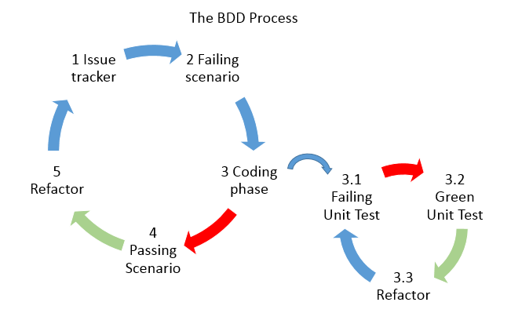
What is BDD
Behavior-driven development is a testing practice that follows the idea of specification by example (e.g., Test-Driven Development [TDD]). The idea is to describe how the application should behave in a very simple user/business-focused language. BDD’s business-focused perspective on application behavior allows teams to create living documentation that is easy to maintain and can be consumed by all team members, including testers, developers, and product owners.

Slide 3

BDD...Gherkin
With BDD, tests are created using the gherkin Given-When-Then language.
given (some context)
when (something happens)
then (outcome)
For example:
Given I am signing up for a free trial
When I submit the required details
Then I receive a link to the download
.

Slide 4
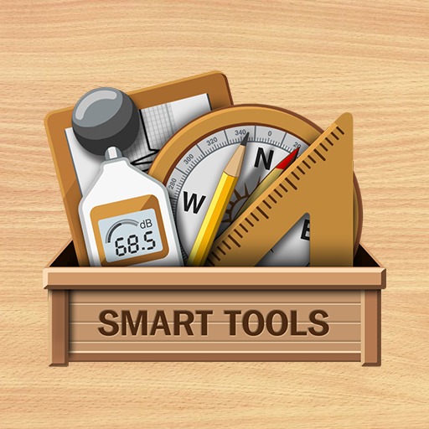
BDD Tools
Popular development testing tools for creating and managing BDD tests are:
SpecFlow: .NET framework
Cucumber: Ruby framework
Gauge: JavaScript, C#, Java, Python, Ruby framework
Tricentis Tosca: Scriptless testing framework for APIs and GUIs
Jasmine: JavaScript testing framework
Tricentis qTest Scenario: Jira BDD plugin
Behat: Php framework
Concordion: Java framework
Squish GUI Tester: BDD GUI testing tool for JavScript, Python, Perl, Ruby, and Tcl)

Slide 5

Cucumber..
Ok, now that you know that BDD is about discovery, collaboration and examples (and not testing), let’s take a look at Cucumber.
Cucumber reads executable specifications written in plain text and validates that the software does what those specifications say. The specifications consists of multiple examples, or scenarios. For example:
Scenario: Breaker guesses a word Given the Maker has chosen a word When the Breaker makes a guess Then the Maker is asked to score

Slide 6
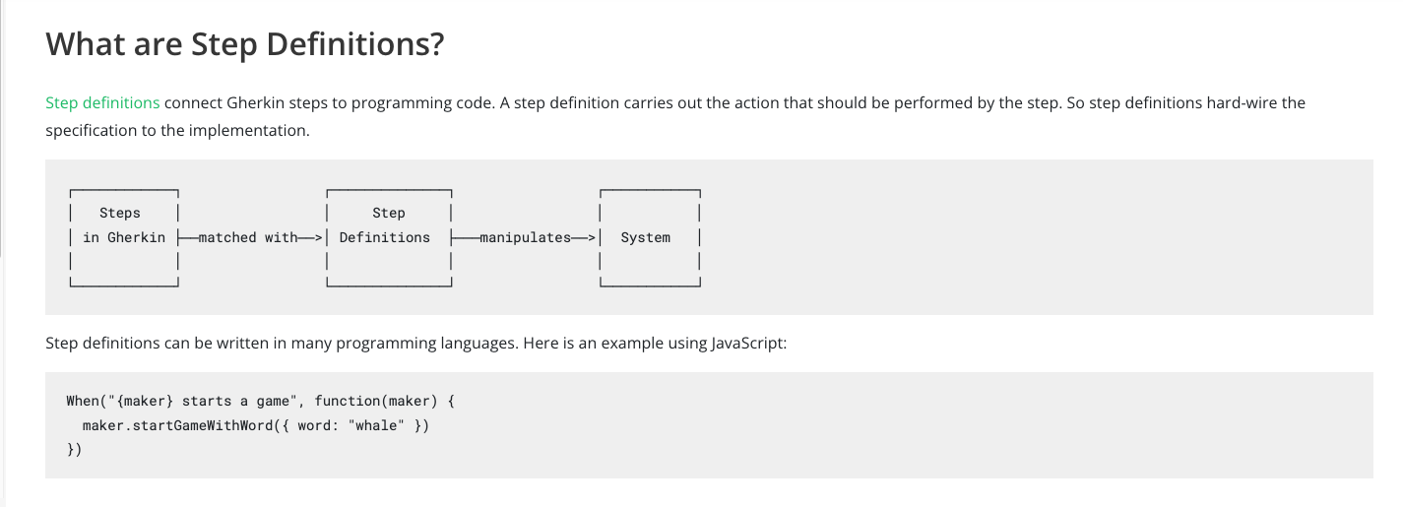
Cucumber..

Slide 7
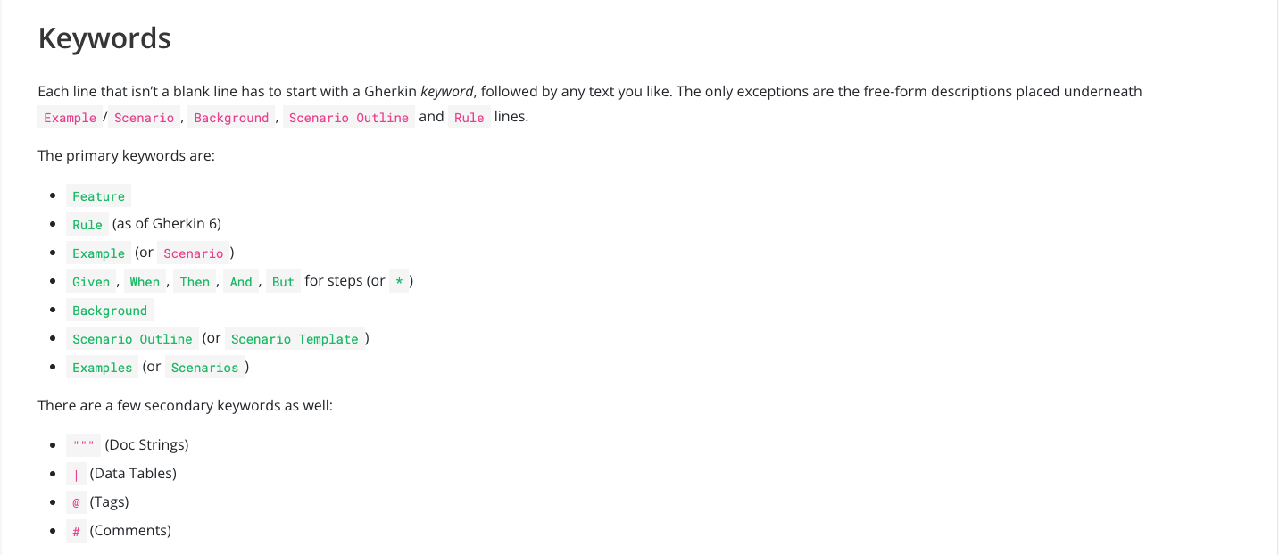
Cucumber..

Slide 8

Cucumber..

